Slide 1

Heart Attack Risk Prediction: Capstone 2 Project
Presented by: Nilesh Suresh

Slide 2
Context
Heart attacks are a major global health issue.
Understanding risk factors can help prevent them.
The dataset includes key health attributes (age, cholesterol, blood pressure, lifestyle habits, etc.).
Using machine learning, we aim to create predictive models for better prevention and management.

Slide 3
Problem Statement
Goal: Build a predictive model to assess heart attack risk.
Method: Use machine learning to identify patterns and correlations.
Impact: Helps healthcare professionals develop proactive strategies.

Slide 4
Data Wrangling
Initial dataset: 8,763 rows, 25 columns.
Cleaning steps:
Rounding values for consistency.
Splitting blood pressure into Systolic & Diastolic.
Encoding categorical features (Sex, Diet, Country, Continent, Hemisphere).
Outcome: A well-structured dataset for further analysis.

Slide 5
Data Features
Numeric Features
Age
Cholesterol
Heart Rate
Exercise Hours Per Week
Stress Level
Sedentary Hours Per Day
Income
BMI
Triglycerides
Physical Activity Days Per Week
Sleep Hours Per Day
Diabetes
Family History
Smoking
Obesity
Alcohol Consumption
Previous Heart Problems
Categorical Features
Blood Pressure
Sex
Diet
Country
Continent
Hemisphere
Target Feature
Heart Attack Risk

Slide 6
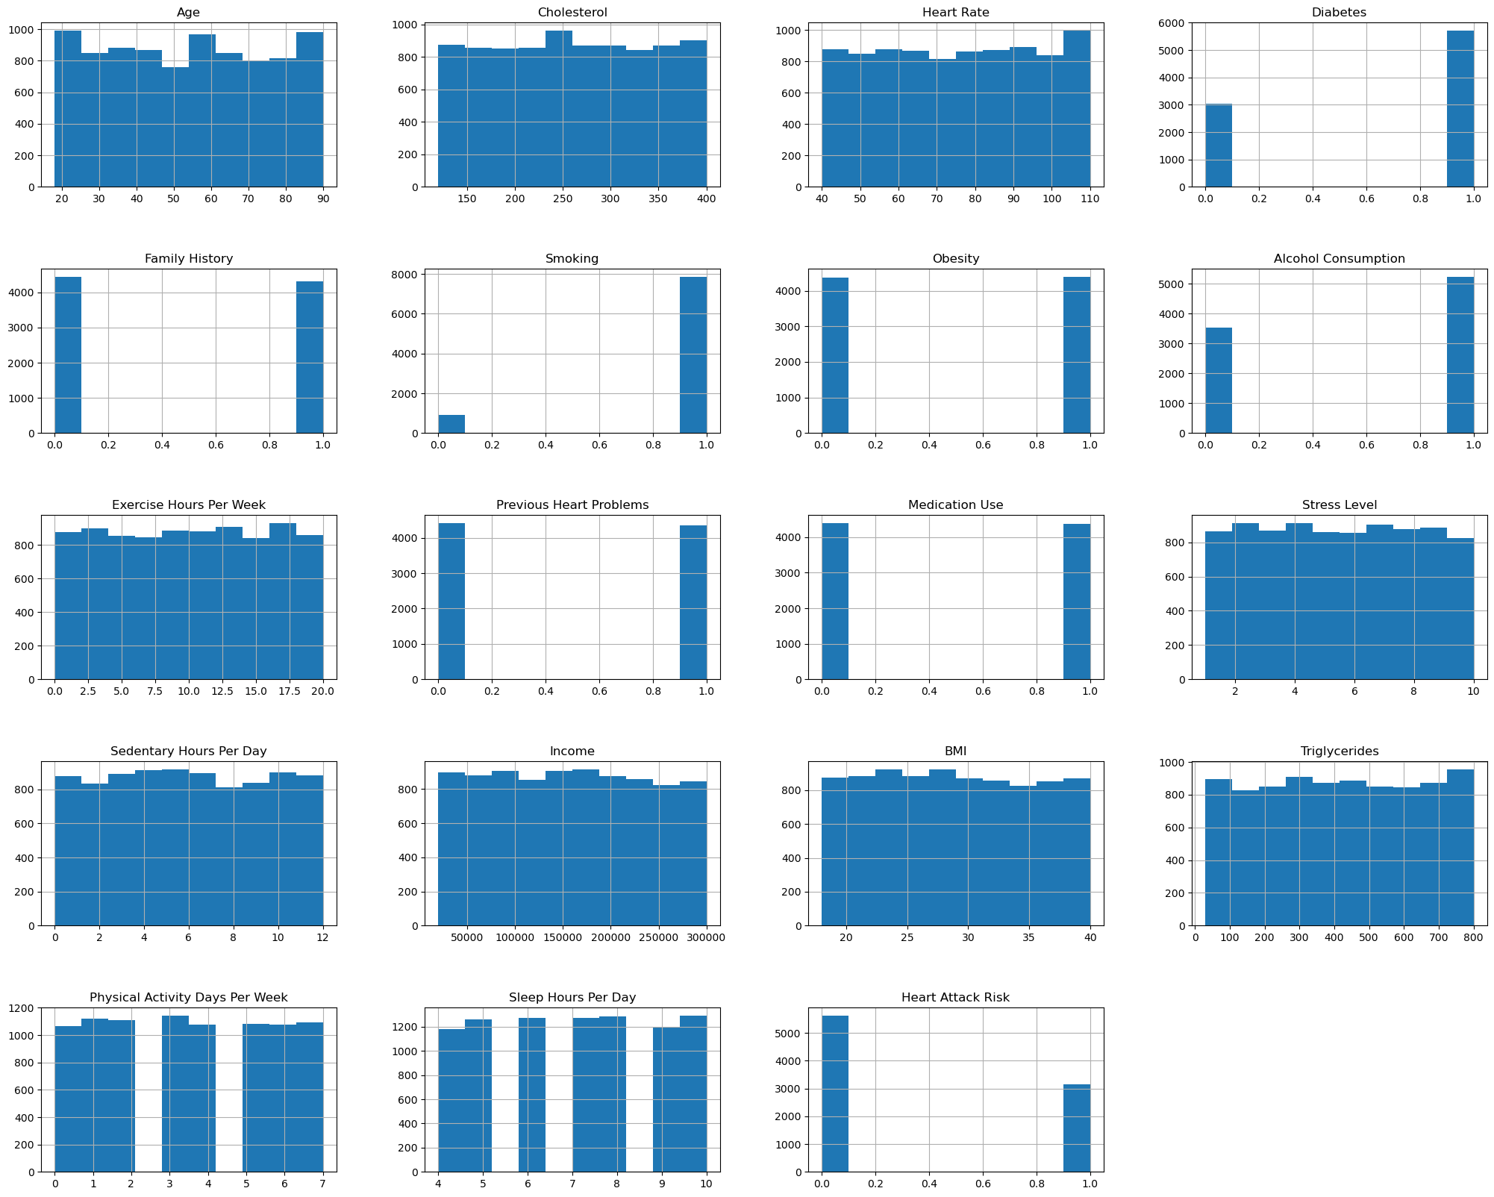
Distributions Of Feature Values
Distribution analyses were conducted for both numerical and categorical variables, confirming that the feature distributions were appropriate for heart attack risk prediction modeling.

Slide 7
Exploratory Data Analysis (EDA)
Purpose: Identify trends, anomalies, and relationships between variables.
Data transformations:
Label encoding categorical variables.
Feature mapping (Cholesterol & Blood Pressure categories).
Key positively correlated features:
Cholesterol, Diabetes, Exercise, Triglycerides, Blood Pressure, Age.
Findings: Older patients with high cholesterol/blood pressure have higher heart attack risk.

Slide 8
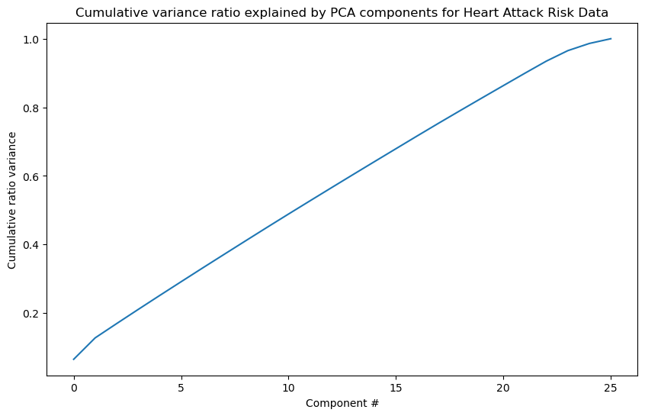
Principal Component Analysis (PCA)
Standardized the dataset using scaling to ensure uniformity across features.
PCA transformation was applied to capture variance in the dataset.
The first principal component (Age) explained 15% variance, with about 80% variance coming from the top 15 components

Slide 9
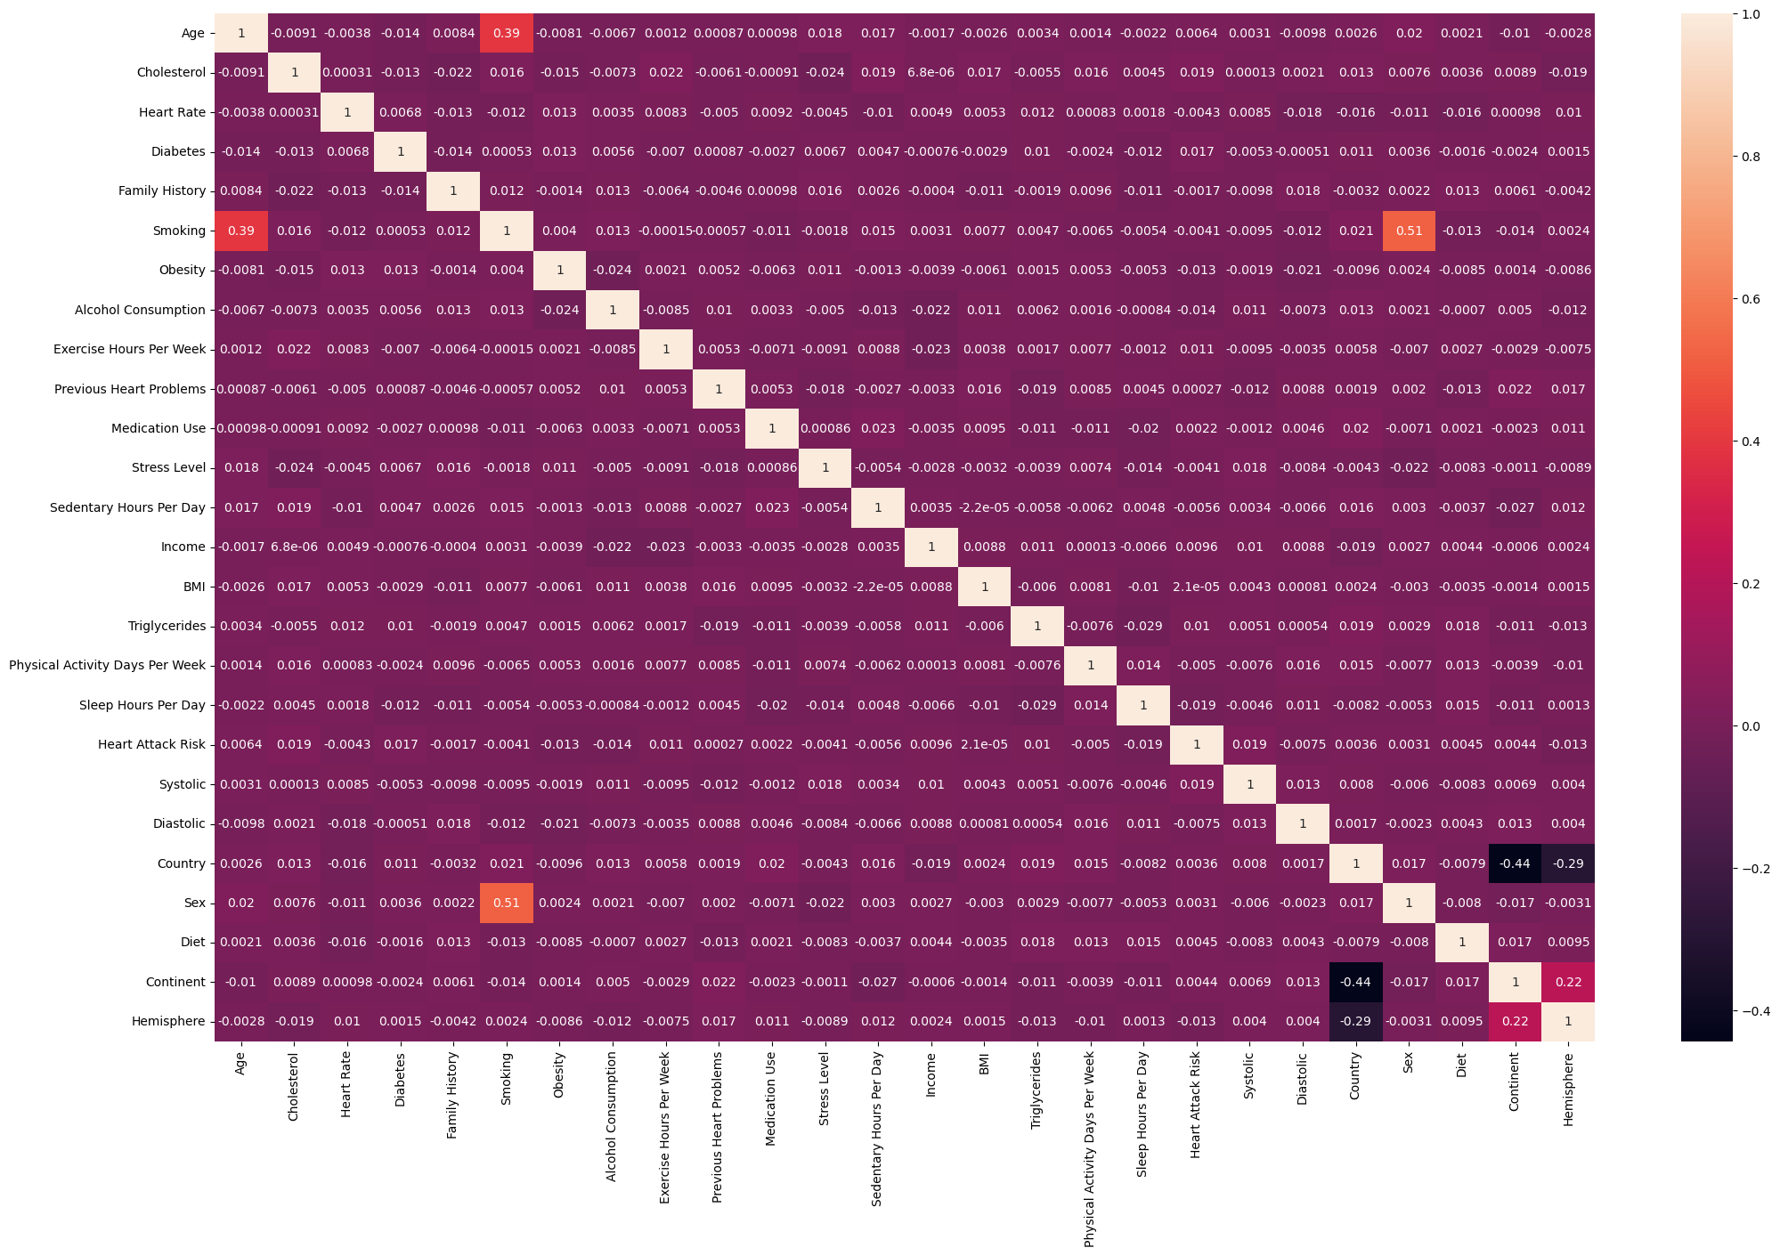
Correlation Analysis
Heatmap visualization revealed strong positive correlations with "Heart Attack Risk", particularly:
Cholesterol
Diabetes
Exercise Hours Per Week
Triglycerides
Systolic Blood Pressure
Age
Previous Heart Problems
Medication Use

Slide 10
Data Preprocessing
Dummy feature creation: Converted categorical variables into numeric format.
Train/Test Split: 80% training, 20% testing.
Outcome: Data ready for machine learning model development.

Slide 11
Modeling Approach
Machine Learning Models Tested:
Logistic Regression
Random Forest
K-Nearest Neighbors (KNN)
Decision Tree
Gradient Boosting
Key Evaluation Metrics: Accuracy, ROC AUC Score, Confusion Matrix.

Slide 12
Model Evaluation
Classifier | Best Hyperparameters | Accuracy | Confusion Matrix | ROC AUC Score
Logistic Regression | C = 0.2113 | 64.10% | Correctly predicted: 4484 No-Risk, 13 Risk cases. Misclassified: 2500 No-Risk as Risk, 14 Risk as No-Risk. | 0.4978 (poor class separation)
Random Forest Classifier | Criterion: gini, Max Depth: 3, Min Samples Split: 2, N Estimators: 200 | 64.10% | Correctly predicted: 4497 No-Risk, 0 Risk cases. Misclassified: 2513 No-Risk as Risk, 1 Risk as No-Risk. | 0.5079 (slightly better but still weak)
KNeighbors Classifier | n_neighbors = 47 | 63.80% | Correctly predicted: 4452 No-Risk, 20 Risk cases. Misclassified: 2493 No-Risk as Risk, 46 Risk as No-Risk. | 0.5070 (similar to Random Forest)
Decision Tree Classifier | Criterion: entropy, Max Depth: 3, Min Samples Split: 2 | 61.90% | Correctly predicted: 4135 No-Risk, 207 Risk cases. Misclassified: 2306 No-Risk as Risk, 363 Risk as No-Risk. | 0.5027 (weak class separation)
Gradient Boosting Classifier | Max Depth: 3, Min Samples Split: 2, Learning Rate: 0.1 | 63.00% | Correctly predicted: 4322 No-Risk, 97 Risk cases. Misclassified: 2416 No-Risk as Risk, 176 Risk as No-Risk. | 0.5134 (slightly better, but weak)

Slide 13
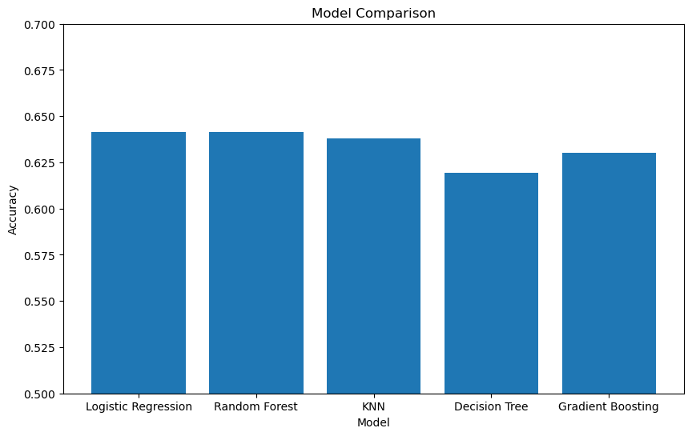
Model Comparison - Accuracy

Slide 14
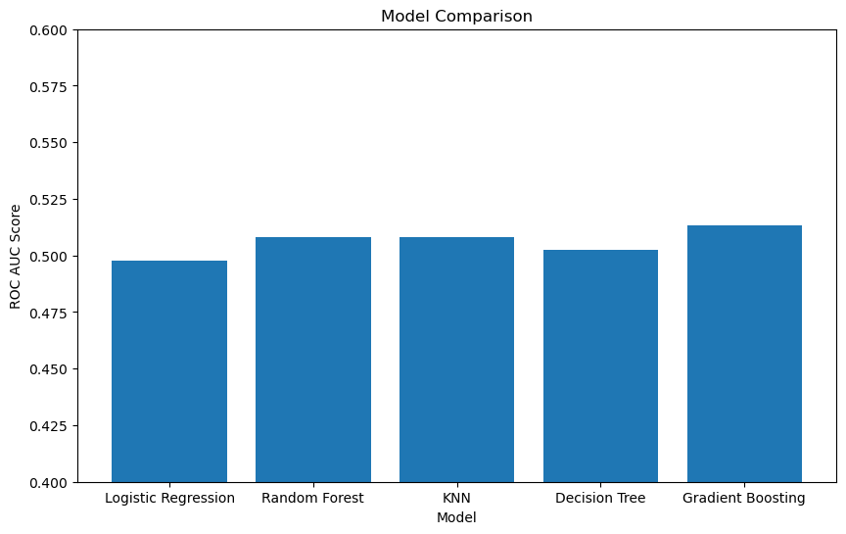
Model Comparison – ROC AUC Score

Slide 15
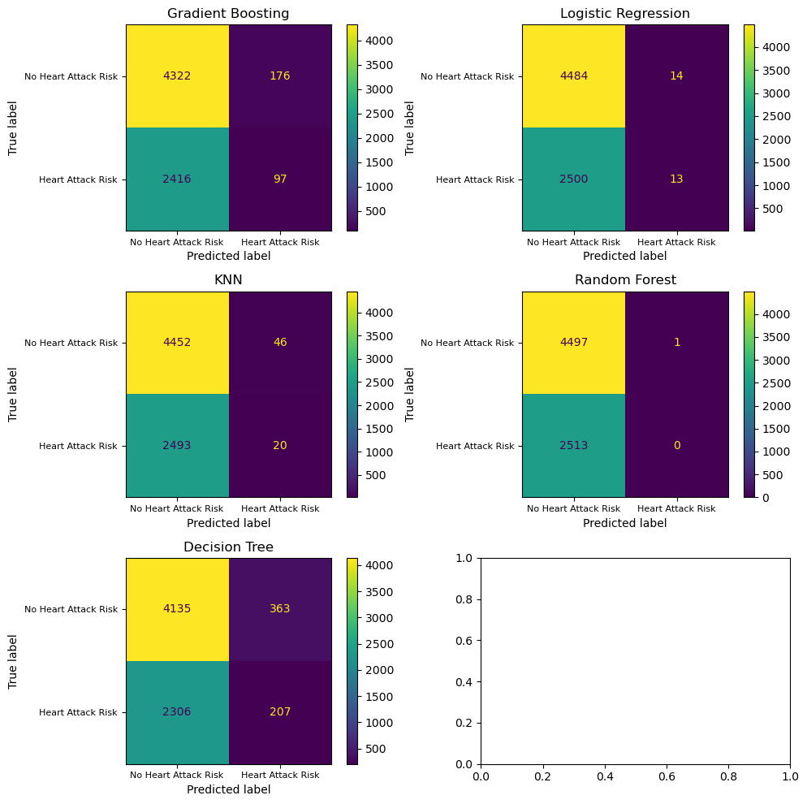
Model Comparison – Confusion Matrix

Slide 16
Model Comparisons & Insights
Best-performing models: Gradient Boosting and Decision Tree.
Key observations:
Strong predictors: Cholesterol, Triglycerides, Blood Pressure, Age, Previous Heart Problems.
High cholesterol & sedentary lifestyle contribute significantly to heart attack risk.

Slide 17
Final Model Selection
Chosen model: Decision Tree Classifier (best at identifying heart attack risk).
Feature Importance:
Top predictors include Triglycerides, Cholesterol, Age, and Exercise.
Scenario Analysis: Simulated risk under different lifestyle conditions.

Slide 18
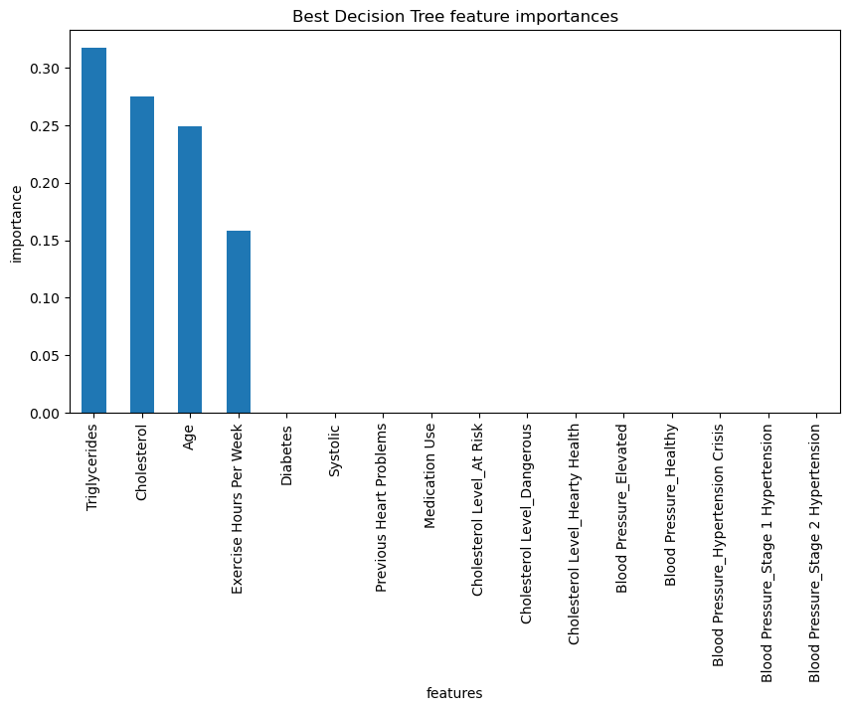
Feature Importance Analysis

Slide 19
Scenarios Tested
Cholesterol Levels:
Normal (180)
At Risk (230)
Dangerous (380)
Triglycerides Levels:
Normal (140)
Borderline (190)
High (450)
Very High (550)
Age Groups:
Young (28)
Middle Age (48)
Senior (68)
Activity Levels:
Sedentary (0.5 hrs/week)
Lightly Active (2 hrs/week)
Moderately Active (4 hrs/week)
Very Active (6 hrs/week)

Slide 20
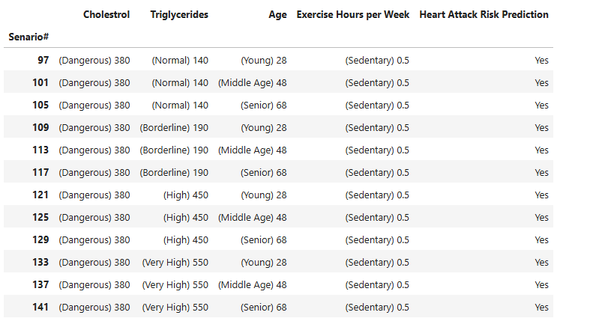
Scenarios with Heart Attack Risk Predicted as Yes

Slide 21
Key Insights from the Simulations
High Cholesterol & Triglycerides increased risk significantly.
Sedentary Lifestyle (0.5 hours/week exercise) was a major risk factor.
Being at least lightly active (2+ hrs/week) reduced risk even with high cholesterol/triglycerides.

Slide 22
Summary & Next Steps
Current Accuracy: 62% (Decision Tree model).
Challenges: Low class separation (ROC AUC Score ~0.50).
Potential improvements:
Use ensemble learning (XGBoost, stacking).
Expand dataset with additional health factors.
Optimize feature selection and hyperparameters.

